Slide 1
The End and the Beginning
Tim Cartwright
OSG Deputy Executive Director and OSG User School Director
University of Wisconsin–Madison

Slide 2
The End…

Slide 3
We must adjust to changing times and still hold to unchanging principles.
Attributed to former U.S. President Jimmy Carter, who attributed it to his high school teacher, Julia Coleman

Slide 4
Why?

Slide 5
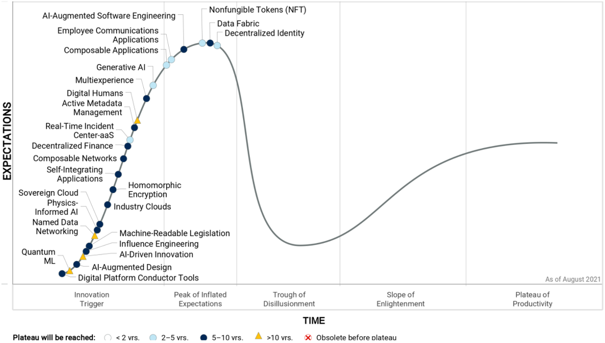
Gartner Hype Cycle
Source: https://emtemp.gcom.cloud/ngw/globalassets/en/newsroom/images/graphs/hc-emerging-tech-2021.png

Slide 6
Recent Paradigm Shifts
1970s Computing capacity packaged and sold in small units
2000s Computing capacity available to lease by the minute
BUT: Principles haven’t changed with these shifts!

Slide 7
A Brief History of HTC
1983 | Miron Livny completes Ph.D. thesis
1985 | First Condor deployment
1992 | Completed run of 250,000 jobs
1994 | LHC approved
1996 | Introduced “High Throughput Computing”
2000 | Start of Trillium project (PPDG + GriPhyN + iVDGL)
2004 | Start of EGEE (Enabling Grids for E-sciencE)
2005 | Start of Open Science Grid
2009 | LHC Run 1 begins
2010 | Perspectives on Grid Computing
2010 | Start of EGI (née European Grid Initiative)
2012 | LHC detects Higgs boson
2015 | LIGO detects first binary black hole merger
2017 | First release of HTCondor Annex, to work with clouds
2022 | PATh Facility deployed

Slide 8
Some Principles

Slide 9
#1: Unity and Autonomy

Slide 10
Two Principles of Distributed Computing
Unity: Parts of system try to reach common goal
Goal determines rules that control independent parts
E.g., OSPool resources should always be running jobs
Autonomy: Parts are autonomous but cooperate
One part can refuse a request from other part
E.g., a resource provider (site) can turn away pilots
There are always trade-offs

Slide 11
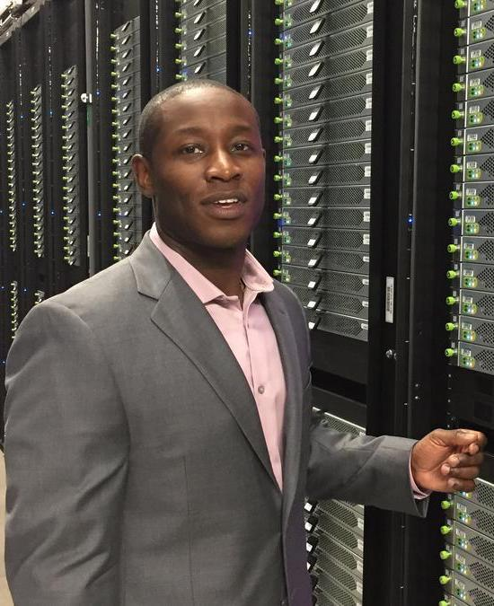
Autonomy => Ownership
In 1985, HTCondor added the idea of resource ownership as a key extension to prior work in distributed computing
Resources have owners, and those owners must have the ability to decide how their resources are used… or else!

Slide 12

HTC Is Sharing
Should I share my resources and, if so, with whom and when?
“HTC is about sharing across many jobs, many users, many servers, many sites, and (potentially) long-running workflows.”
Miron Livny

Slide 13
Sharing Leads to Community
“Now you have a community of customers who are motivated to share and act as consumers, providers, or both.”
– Miron Livny

Slide 14
#2: Automation

Slide 15
HTC Needs Automation
HTC requires automation, as it is a 24-7-365 activity that scales well beyond human interaction
FLOPY ≠ FLOPS × (60×60×24×365)
1 job × 100 KHrs ≠ 100K jobs × 1 Hr

Slide 16
Automation I: Get Resources & Run Jobs
Central Manager
negotiator
collector
2. request job details
3. send jobs
4. notify of match
send periodic updates
Submit Machine
5. claim
Execute Machine
schedd
startd
1. submit job
6. start
6. start
7. transfer exec, input
shadow
starter
9. transfer output
8. start
job

Slide 17
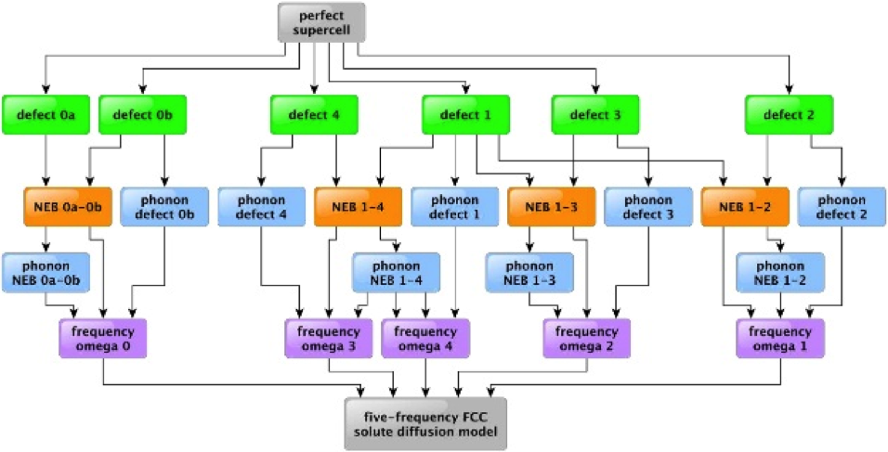
Automation II: User Workflows
Source: Professor Dane Morgan, University of Wisconsin–Madison

Slide 18
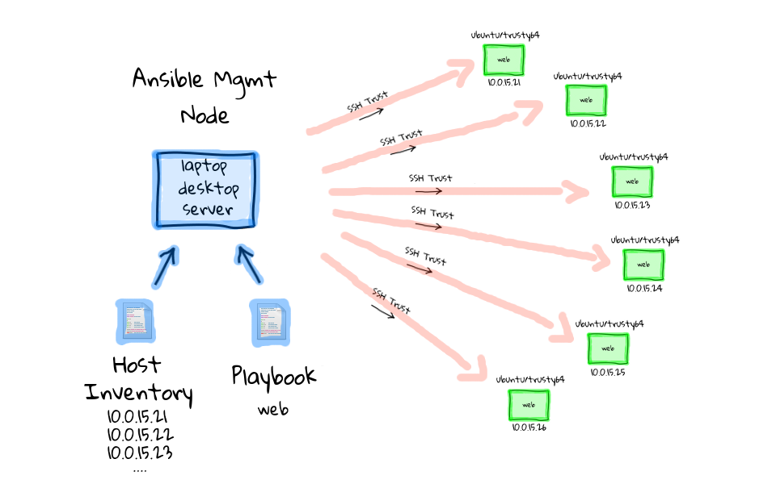
Automation III: System Maintenance
Diagram: Justin Weissig, https://sysadmincasts.com/episodes/43-19-minutes-with-ansible-part-1-4

Slide 19
#3: Submit locally, run globally

Slide 20


Slide 21
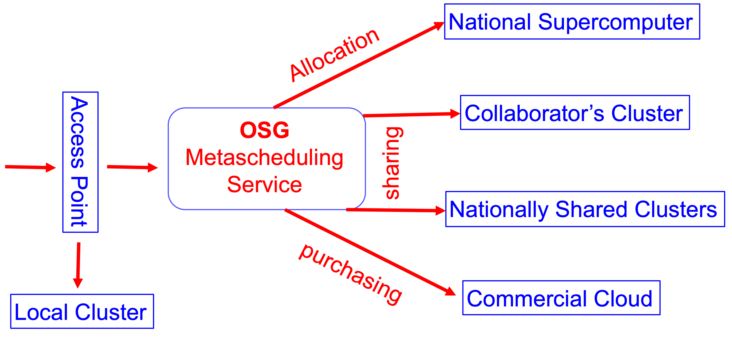
OSG Is Getting There…

Slide 22
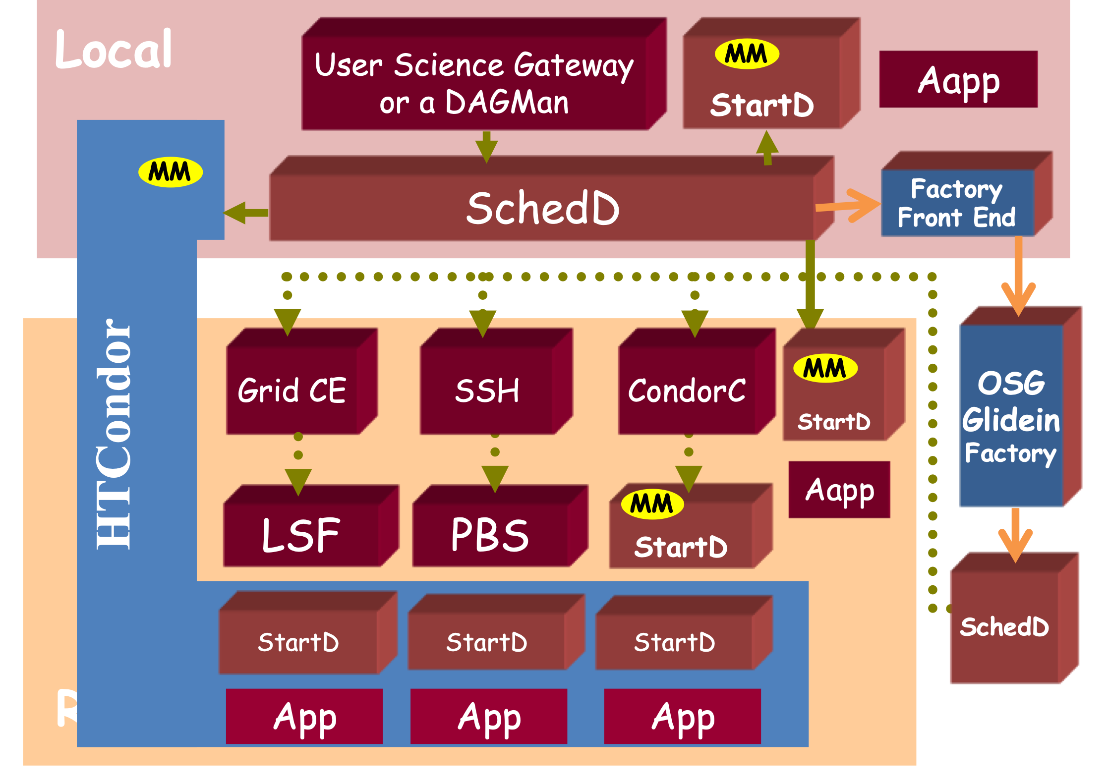
… But It Is Still Complex …

Slide 23
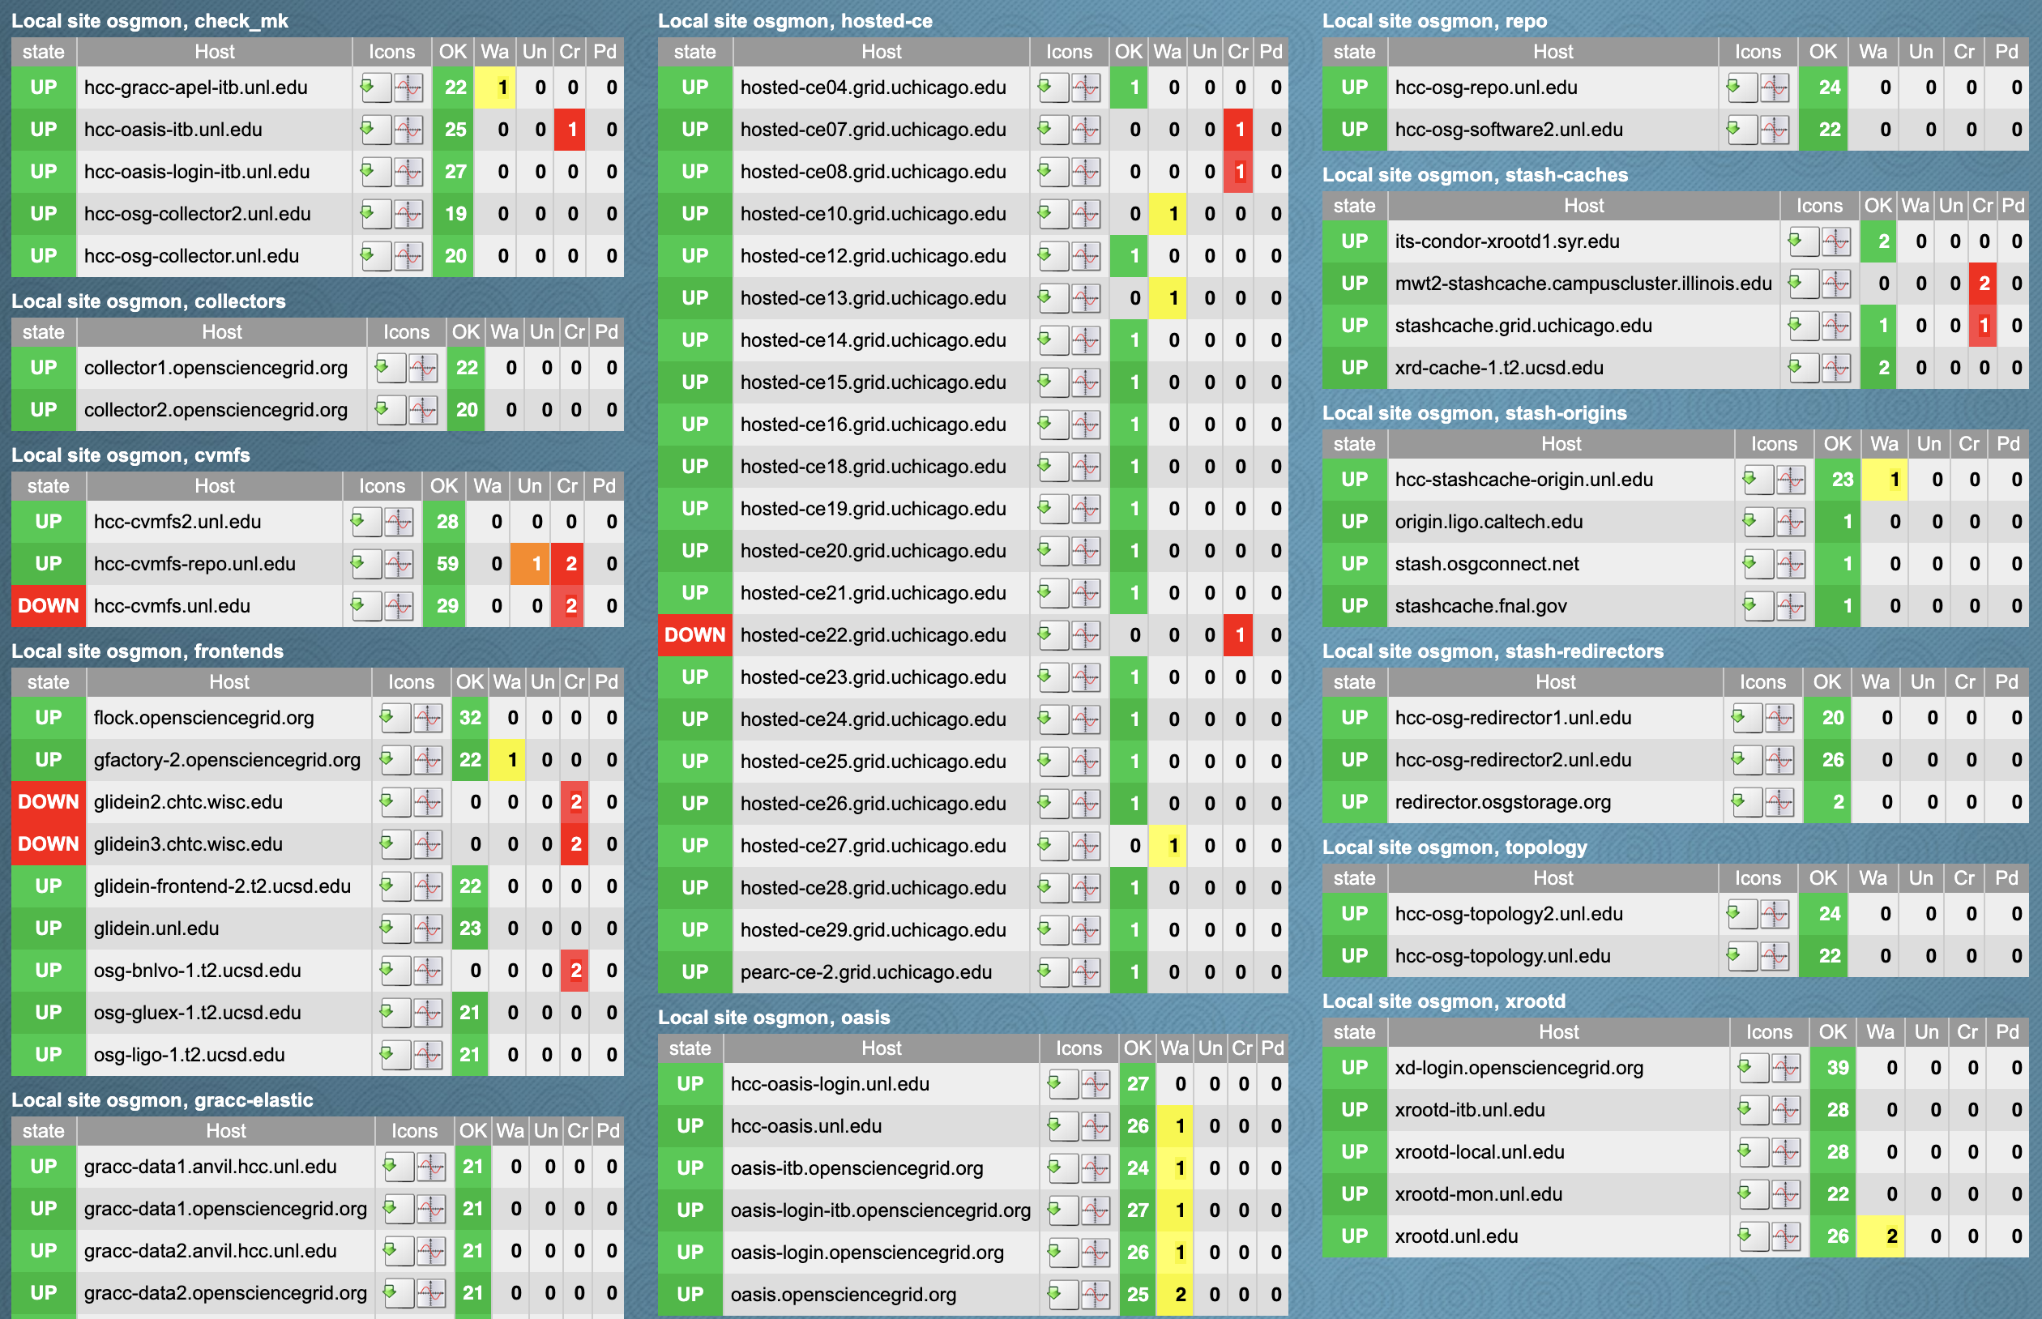
… and Takes a Lot of Care

Slide 24
#4: Focus on Users

Slide 25
User-Centered Design & Development
HTCondor has been driven by what users (you!) need and expect, balanced with core principles
In contrast with “If you build it, they will come.”
Example: Edgar Spalding – his early work pushed our abilities to handle large input files (images)

Slide 26
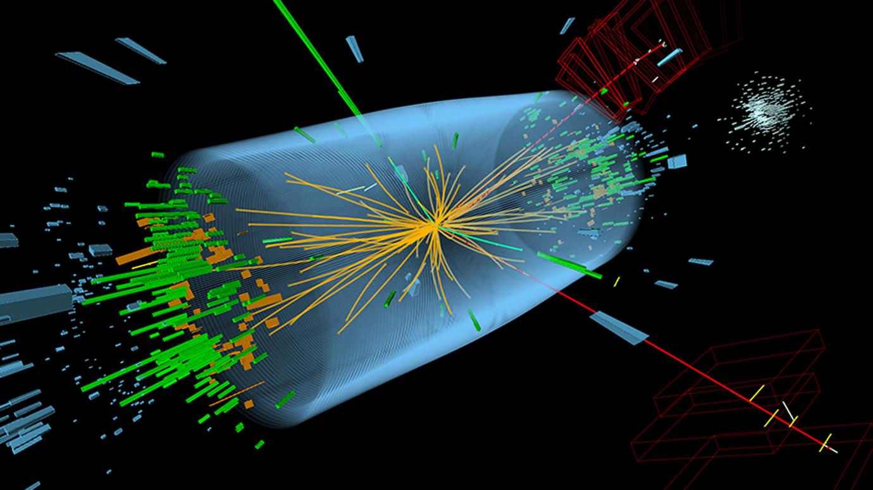
Large Hadron Collider

Slide 27
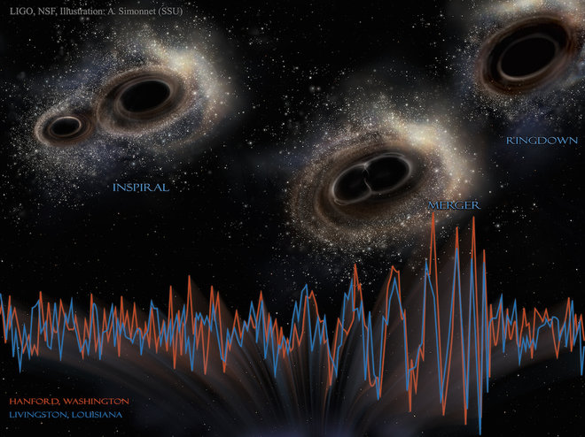
IGWN (LIGO-Virgo-Kagra)

Slide 28
Event Horizon Telescope
Source: EHT Theory Working Group, CK Chan

Slide 29
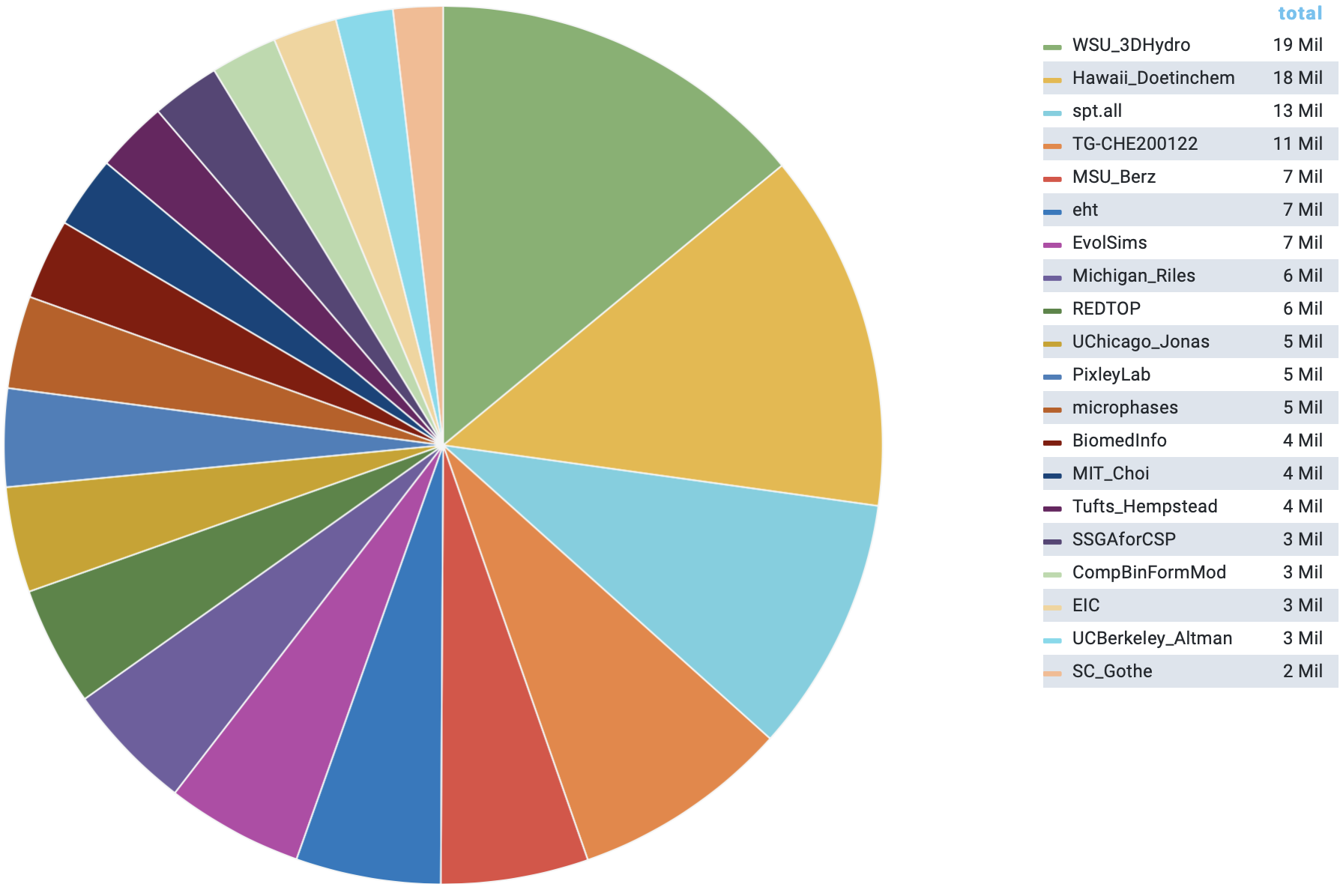
Computing for All of Science

Slide 30
Who Is Next?

Slide 31
#5: Teach To Fish

Slide 32
Teach To Fish
Give a person a fish and you feed them for a day.
Teach a person to fish and
you feed them for a lifetime.

Slide 33
What Does “Teach to Fish” Mean for Us?
Spurs innovation
Researchers who understand their own computing tools can see ways to innovate and make discoveries
For example, our Showcase speakers!
Multiplies effort
By teaching researchers (you!) to solve computing challenges, we can help many people with few staff
And if you teach others (in your lab, etc.), our effort becomes exponentially powerful

Slide 34
Some Statistics on OSG Facilitation
375 new OSG Connect accounts in past year (each with initial consultation, at least)
80 tickets (support, ) in past quarter
26 institutions engaged in past quarter
20 visits to office hours in past quarter
All with just 2.5 FTEs over five people!

Slide 35
… And The Beginning

Slide 36
Getting Resources

Slide 37
Free Resources – In Your Lab
Server or cluster in your lab
Not your laptop, control everything
Buy and maintain it, not a lot of resources
https://images.abmx.com/30/3004/abmx_3004_1_1200.jpg

Slide 38
Free Resources – Local Cluster
Department or campus cluster
No/low direct costs, local help
Shared; maybe Slurm, PBS/Torque, LSF…
No campus cluster? Talk to CIO!
Note! NSF CC* Compute awards
https://www.nsf.gov/pubs/2021/nsf21528/nsf21528.htm
https://www.pngall.com/wp-content/uploads/5/Server-Rack-PNG-Free-Image.png

Slide 39
Free Resources – Collaborators
Collaborators
No/low direct costs, may be tailored to project
Shared, project-specific, hard to come by
https://www.dunescience.org/about-the-collaboration/

Slide 40
Free Resources – Science Gateways
Science Gateways (e.g., web front-end to a cluster)
Easy to use, no/low cost
Only for pre-defined use cases

Slide 41
Commercial Resources
Commercial clouds (Amazon, Google, Microsoft, …)
Don’t own, high availability, many options (e.g., GPUs), …
Pay/hour, data out may be costly; challenging to manage
Managed clouds (Azure CycleCloud, Globus Genomics, …)
As above, but less to manage
Costs more (paying someone to manage), fewer options?
But keep commercial options in mind:
Credits may be available
May be able to write into grants
May be helpful for burst of activity (e.g., for a deadline)

Slide 42
PATh Facility
The PATh Facility is a purpose-built, national-scale dHTC resource meant to deliver computational capacity to NSF researchers
New in 2022!
Can apply for credits – existing or new NSF award
Credits go toward dedicated dHTC resources
See PATh website and NSF DCL 22-051 for more: https://www.nsf.gov/pubs/2022/nsf22051/nsf22051.jsp

Slide 43
Your School Accounts
learn.chtc.wisc.edu – may keep for ~1 year
We will warn you before removing account
OSG Connect account
If just created for School, temporary (~1 month)
But, just take easy steps to convert to full account
See School website: https://osg-htc.org/user-school-2022/logistics/projects/
Remember that Access Points are not backed up!

Slide 44
Staying in Touch

Slide 45
How to Reach Us
For OSG Connect, Connect Client, OSG sites…
user-support@opensciencegrid.org
Reaches the OSG Research Computing Facilitators
For learn, CHTC, and anything else
user-school@opensciencegrid.org
Reaches Tim and Christina… and indirectly, many others
Any time, for any reason, email us directly:
Tim Cartwright <cat@cs.wisc.edu>
Christina Koch <ckoch5@wisc.edu>

Slide 46
Online Support
Websites
htcondor.org HTCondor homepage
htcondor.org/manual HTCondor manual
www.opensciencegrid.org OSG homepage
support.opensciencegrid.org Forums, docs, support
osgconnect.net OSG Connect
chtc.cs.wisc.edu CHTC Website
chtc.cs.wisc.edu/guides CHTC How-To Guides
Mailing Lists
user-school@opensciencegrid.org will remain
help@opensciencegrid.org general OSG help

Slide 47
Meetings
OSG All-Hands Meeting
Traditionally in March, likely moving for 2023
David Swanson Award => former School participant
HTCondor Week
European HTCondor Workshop

Slide 48
Final Logistics

Slide 49
Saturday Morning

Slide 50
Travel
Transportation emails went out today
Most people will take taxi/rideshare
Payer should write down who shared the ride
Remember the travel advice page: https://osg-htc.org/user-school-2022/logistics/travel-advice/
If you encounter issues:
Try the airline first
Call Travel Inc. if necessary (we are charged $18)
Let us know (if you want to and have time)

Slide 51
Reimbursements
What can be reimbursed?
Bus fare to/from Madison (if you paid)
Taxi or rideshare to/from Madison airport
Driving mileage, if prearranged
Dinners (Sunday – Thursday), up to $30 each
Other prearranged things
It is best to have actual receipts
How to get reimbursed? https://osg-htc.org/user-school-2022/logistics/reimbursements/

Slide 52
Short Essay (If No Lightning Talk)
Similar to the lightning talks, but written
Basic summary of current research work
One key computational challenge
How will you apply new knowledge & skills to research?
Due by the end of August
Submit to School mailing list for review

Slide 53
Forward

Slide 54
Temper Hype With Principles

Slide 55

How to Work With Us
We are driven by user needs and expectations, plus our principles
So push us to help make your research possible
And we may push on you to take your work even further!
Photo: SafetySign.com

Slide 56
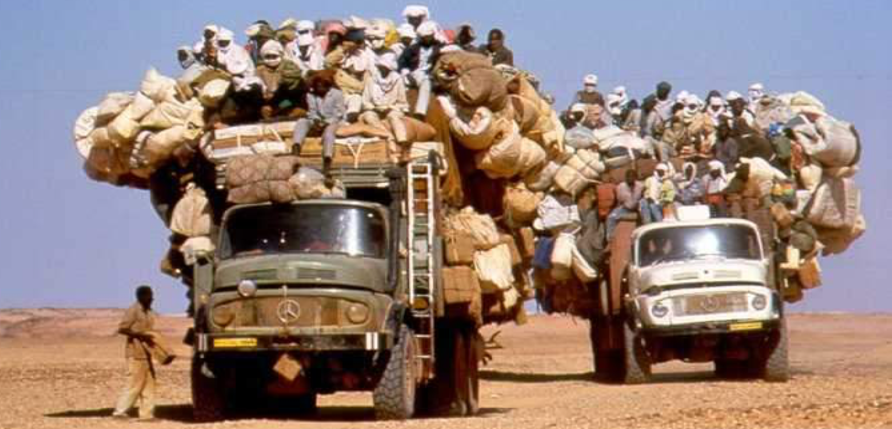
Be Part of the Community

Slide 57
Don’t let computing be a barrier to your science!

Slide 58
THANK YOU!

Slide 59
Closing Dinner
Union South, Industry Room and outside
(3rd floor)
6:30 p.m.

Slide 60
Acknowledgements
This work was supported by NSF grants MPS-1148698, OAC-1836650, and OAC-2030508

